Slide 1
Ascension Technology
C.A.R.
Matthew Darby, Maggie Burton, Weston Straw, Mark Du, Andrew Case, Stevie Damrel

Slide 2
Where we are now

Slide 3

Class Diagram

Slide 4
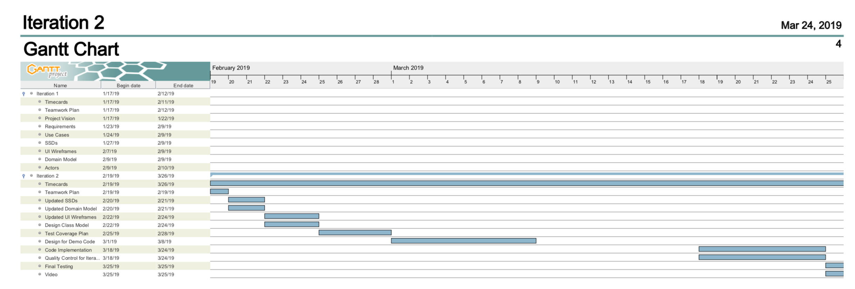

Slide 5
Communication Diagram: User Rent Car

Slide 8
Website
https://baylorsailor.github.io/C.A.R./site

